Slide 1

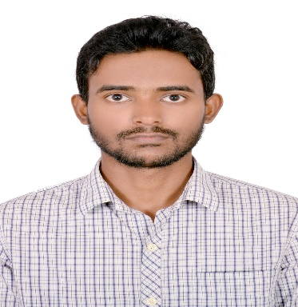





Md Intekhab Alam
Education and certificates
Bachelor of Technology
Electronics & Communications: 2016 - 2020
Analyst/Software Engineer
Skills
Core Java
Spring Boot
Spring MVC
JPA CRUD/JPA MONGODB
Base Location: Bengaluru
Email ID:
md-Intekhab.alam@capgemini.com
_{Mobile No:} +916363122189
Grade:
A4
Backend
Spring Boot/Spring Security MongoDB
REST-API
Strengths
A self driven learner with Front-End and Back-End knowledge. Passionate about implementing and launching new projects.
Ready to learn new technologies/Frameworks and implement them to further improve my knowledge.
A team player with good communication skill always ready to work for the enrichment of knowledge.
Has working knowledge on Java Microservice Development using Spring framework on an intermediate level.
Achivement
Crop Management System Application
Completed end to end case study of Crop Management System along with JWT authentication, Swagger and Billing System using Spring boot Microservices with Eureka Server..
Database
SQL database – MySQL
No SQL database – MongoDB
Coded and designed Static Web Pages
Web Technologies
HTML5 CSS3
Javascript/TypeScript
Developed website with HTML5 and CSS3 Along Frameworks like SASS(Syntactically awesome style sheets) to make website more interactive and dynamic.
AddOns Github Maven Postman
Also Implemented Eureka Server and API gateway in case study and upskilling day by day.
Additional Details
Excellent Communication Skills
Team Player
Check out my work on GitHub & Video Profile
Presentation Title | Author | Date © Capgemini 2017. All rights reserved | 1

